Slide 1
Third Lent Talk 20th and 21st March 2025
Notes:
1

Slide 2
Living Hope
This Lent, in the Lay Community, we are being encouraged to put down deep roots of hope by connecting with God who is always with us. We will be doing this in several different ways, and we will be, especially, using the resources from The Church of England’s Lent theme for 2025 ‘Living Hope’ as our guide.

Slide 3
Pope Francis https://www.cbcew.org.uk/jubilee-2025-letter-from-pope-francis
‘We must fan the flame of hope that has been given us, and help everyone to gain new strength and certainty by looking to the future with an open spirit, a trusting heart and far-sighted vision. The forthcoming Jubilee can contribute greatly to restoring a climate of hope and trust as a prelude to the renewal and rebirth that we so urgently desire; that is why I have chosen as the motto of the Jubilee, Pilgrims of Hope.’

Slide 4
Booklets for adults and children and family resources:
Living Hope reflections booklets, prayer cards for adults and families are available to order now from Church House Publishing.
Reflections via email: Sign up to the Lent reflection emails and receive daily messages .These will offer Bible readings, short reflections and a practical challenge, as well as prayers linked to weekly themes.
Daily reflections via Everyday Faith app: You can read and listen to daily Lent reflections from 5th March through the Everyday Faith app, the new daily devotional app from the Church of England.

Slide 5
Lent Group Week 3 20th/21st March
Together
In this third week of Lent, we’re going to think about how we are designed for community – to build one another up and to allow ourselves to be built up by others. In this way, God enables us to remain rooted in hope and to become a hopeful presence in our communities.

Slide 6
Opening Prayer
Sustainer God, as we walk together through this cross shaped life, we ask that you help us remember that we are your body in the world. Empower us each day to be your salt and light, bringing hope and healing to fractured and broken places. Help us to always remember that we are called to be agents of reconciling love, lights kindled by the fire of resurrection life. Amen.

Slide 7
Reading: Matthew 5:13-16
‘You are the salt of the earth; but if salt has lost its taste, how can its saltiness be restored? It is no longer good for anything, but is thrown out and trampled under foot.’
‘You are the light of the world. A city built on a hill cannot be hidden. No one after lighting a. lamp puts it under the bushel basket, but on the lampstand, and it gives light to all in the. house. In the same way, let your light shine before others, so that they may see your good. works and give glory to your Father in heaven.’

Slide 9
Information Slide
Ubuntu is an African philosophical concept emphasising our interconnectedness and mutual dependence as human beings. Often summarised as "I am because we are," it stresses that a person's humanity is bound up in their relationships with others and the community.
Many African theologians and Christian leaders, including Archbishop Desmond Tutu, incorporated Ubuntu principles into their Christian theology and practice, particularly during South Africa's Truth and Reconciliation Commission. Tutu often described Ubuntu as reflecting the biblical understanding that humans are created in God's image and designed for community.

Slide 10
Questions for Discussion
What struck you from the reflections you read over the past week? Did you try any of the challenges from the resources? If you did, is there anything you noticed?
What are your initial thoughts about what you heard in the small reflection on togetherness from the video?
How does being in community bring you hope and help you to be a person of hope?
In what ways does the Lay Community or the Benedictine tradition help in this regard?
Do you sense that God is inviting you to be less you and more we? What might this look like?

Slide 12
Silent Prayer
A space where we can briefly drop into the silence the name of any people, situations, or places where God’s hope, God’s Yes, is needed at this time
Please un-mute to share your word or phrase aloud.
Be mindful this is a public place, and only share others’ personal information if you have their consent to do so in a public setting.

Slide 13
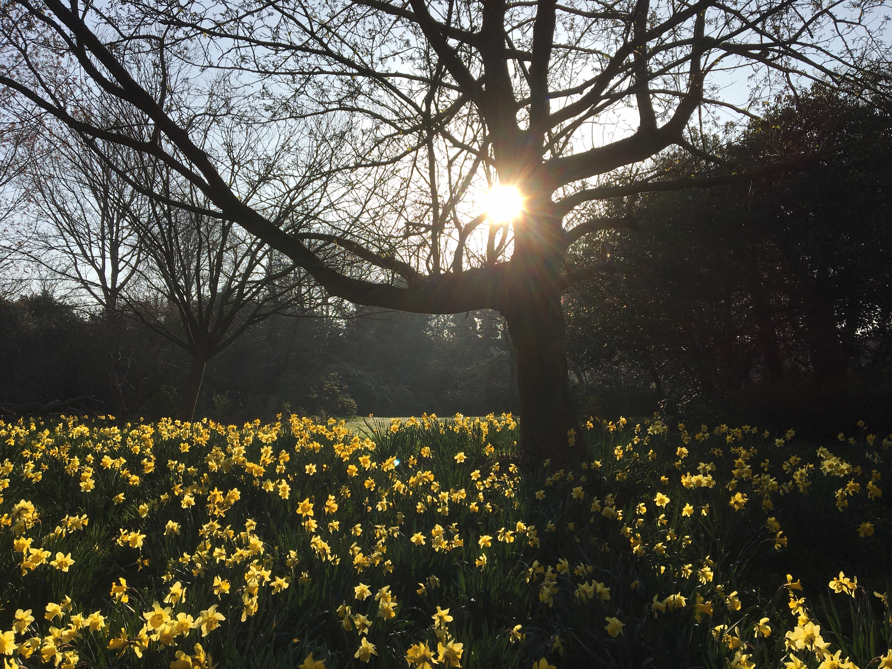
Closing Prayer
May the grace of our Lord Jesus Christ, and the love of God, and the fellowship of the Holy Spirit be with us all, now and evermore. Amen.

